Slide 1
Internship (Kafka Streaming)
Ellie Lee, Edgar Lee, Hayeon Kim, Wonjun Lee
(7.Jan.2019~22.Feb.2019)

Slide 2
Contents.
Python problems
Hot weather practice
Problem setA & setB
Latest 5 problems

Slide 3
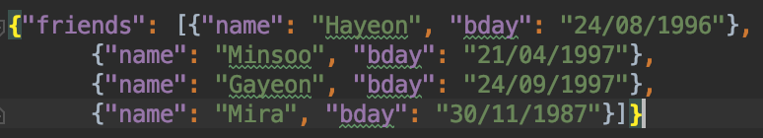
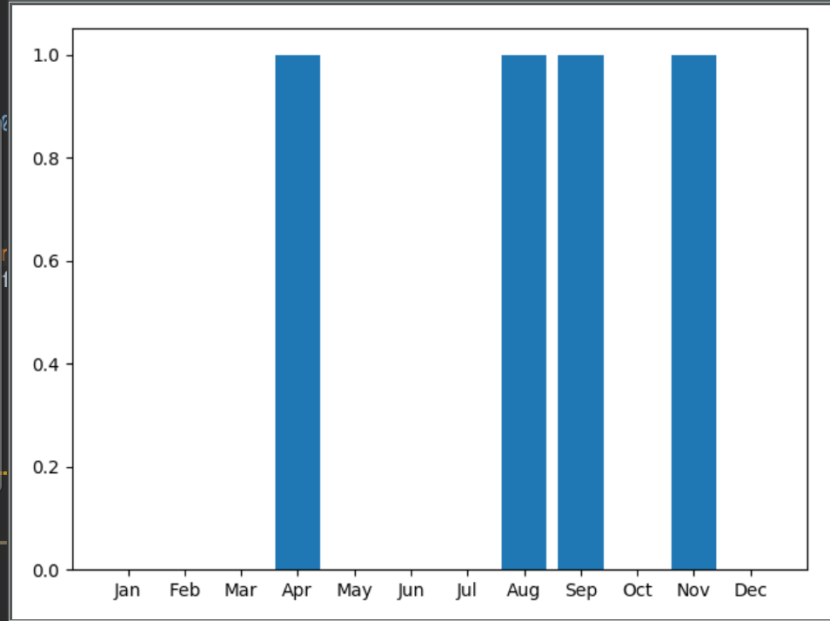
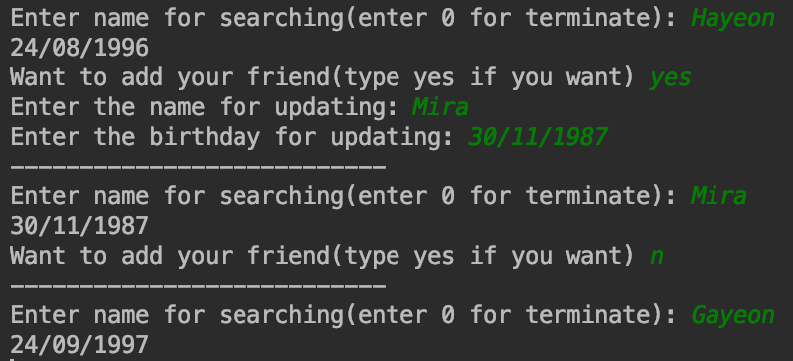
Python practice
<friends.json file>
Birthday problems
Getting used to Python programming
Get input, print output
Utilize json
Plotting graph using matplotlib
<Execution of problem 2>
<Execution of problem 4>

Slide 4
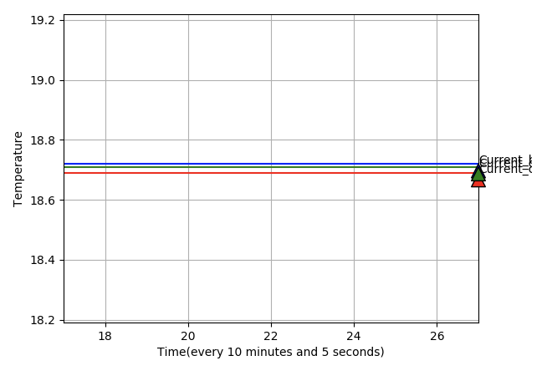
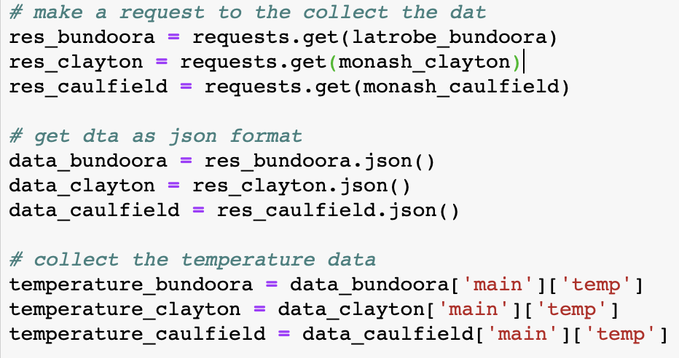
Hot weather exercise
<Final result>
Plotting temperature of three campuses(La Trobe Bundoora, Monash Caulfield, and Monash Clayton)
Find the coolest campus by printing the minimum temperature or three campuses.
Utilizing weather API was the point
<API usages>
<Execution of the problem>
<Getting temperature data>

Slide 5
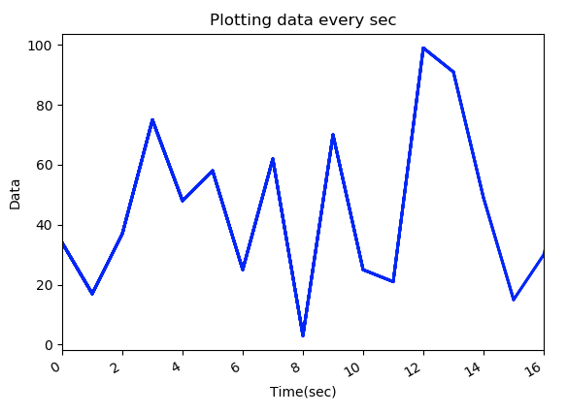
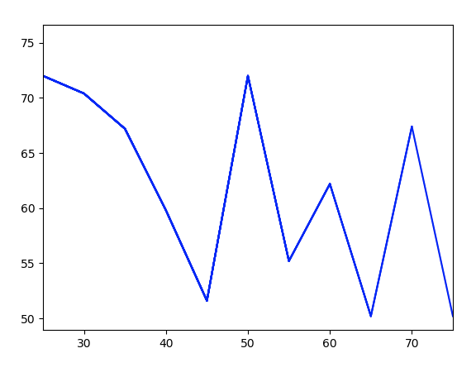
Problem setA(1~2)
What we’ve learned:
Generating data from kafka producer then plotting and utilize on kafka consumer
Utilize Apache Kafka & kafka Python
Steps of problem 2:
Run the zookeeper server and Kafka server.
Create Kafka producer and Kafka consumer.
Kafka producer sends random data to Kafka consumer every second.
Kafka consumer receives that data and plots the mean value of the past five seconds using matplotlib library.
<Execution of problem1,2>

Slide 6
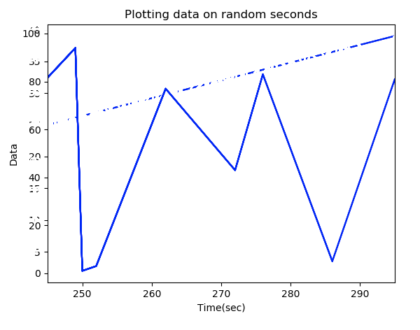
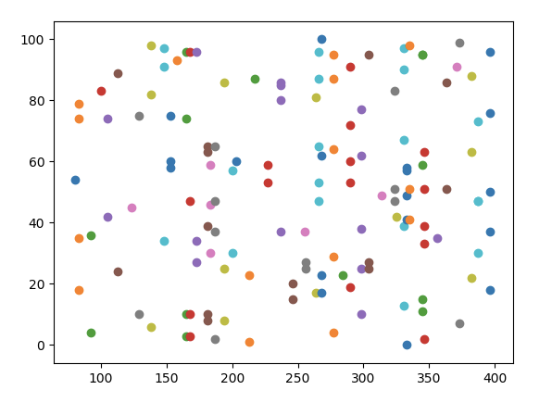
Problem setA(3~4)
Problem 3:
Plotting random data from producer where producer generates data at random sec.
Problem 4:
Producer generates data in random time, random amount of data in random range from 1-100. Consumer plots the data.
<Execution of problem 3>
<Execution of problem 4>

Slide 7
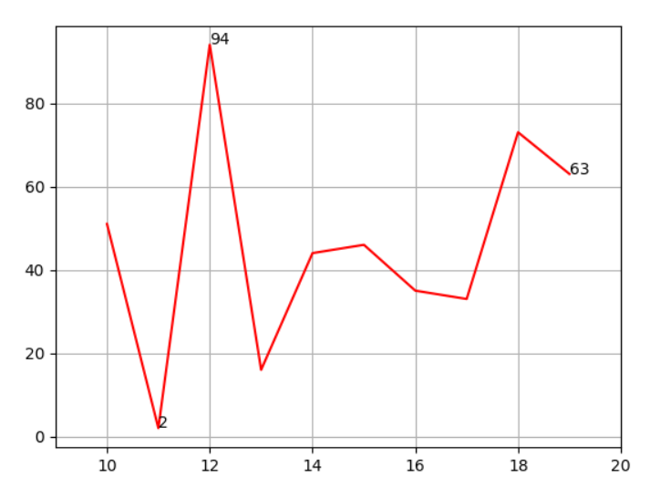
Problem setA(5)
Description:
The data has no boundary, but the consumer will draw the graph anyways. Additionally, show maximum, minimum, and current value on the graph
Step:
Run the zookeeper server and Kafka server.
Create Kafka producer and Kafka consumer.
Kafka producer sends random data to Kafka consumer every second.
Kafka consumer receives that data and plots the data of maximum, minimum for 10 seconds, and current data using annotation of matplotlib
<Execution of problem 5>

Slide 8
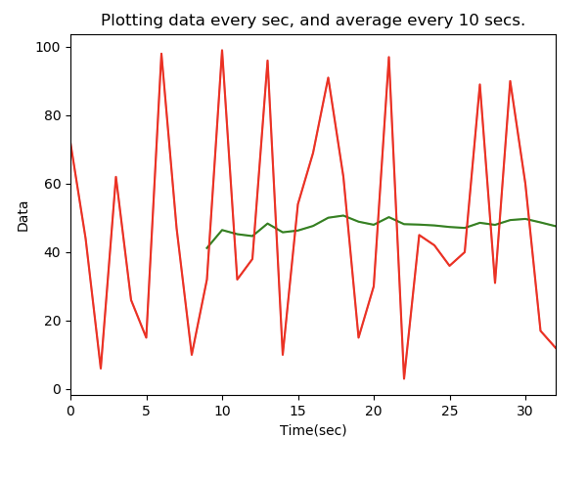
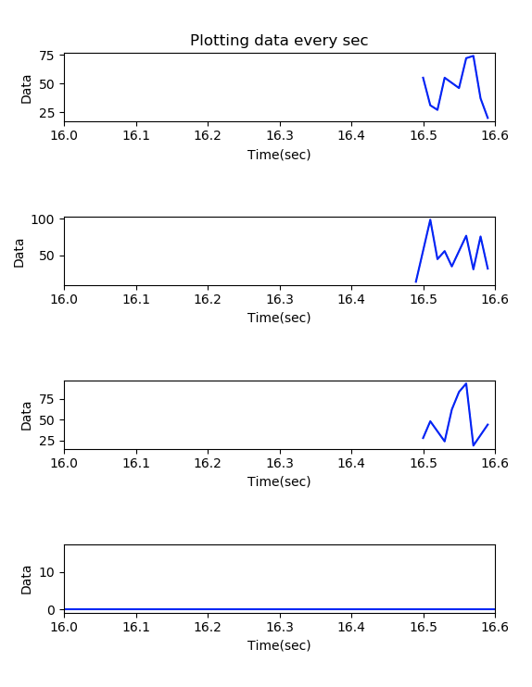
Problem setA(6~7)
Problem 6:
Plotting data every second, and show the average of last 10 seconds
Problem 7:
Consumer gets data from 3 different producers and plot the data with another graph of showing average of three producers
<Execution of problem 6>
<Execution of problem 7>

Slide 9
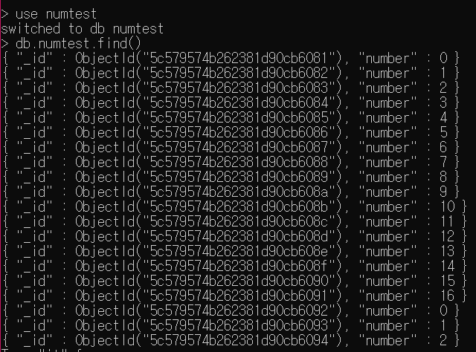
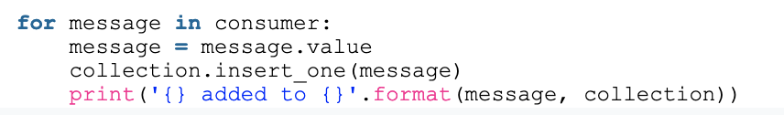
Problem setB(1)
What we’ve learned:
Store at mongoDB with pymongo
Steps are same with setA except storing at mongoDB
<Storing data to the database>
<Result in mongoDB>

Slide 10
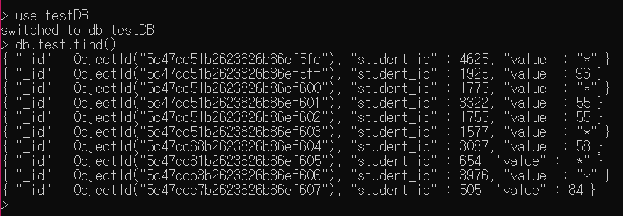
Problem setB(2)
Description:
Generate data every second from Kafka producer, Kafka consumer has to check whether it has null value. If it has null value, that data represent (ex. “*”) in mongoDB table.
Steps:
Run the zookeeper server and Kafka server.
Create 3-Kafka producer and Kafka consumer.
Connect the mongoDB (command mongod).
Kafka consumer checks if value exists, and valid range.
Then, insert data into mongoDB.
After checking, If no value, represent “*”. DB update.
<Result in mongoDB>

Slide 11
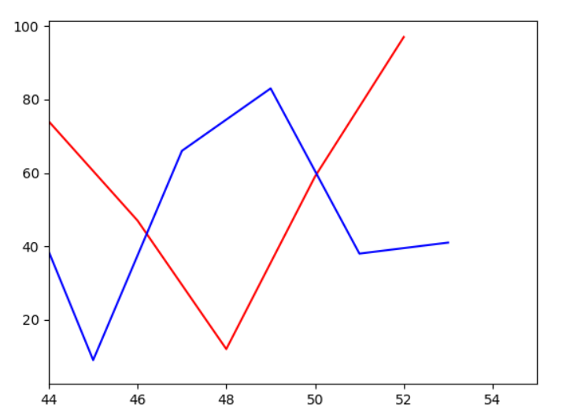
Problem setB(3)
Description:
The problem is to send random values between 0 and 100 from two producers and then plot two received values onto a single graph. Finally save to mongodb. Steps:
Steps:
Run the zookeeper server and Kafka server.
Create 2-Kafka producer and Kafka consumer.
Connect the mongoDB (command mongod).
Plots data from two producers in different colors.
Then insert the data into mongoDB
<Plotting result>

Slide 12


Problem SetC(1,2)
Real time twitter sentiment analysis using kafka & word analysis(plot)
Solving steps:
Receive data from Twitter via Twitter API.
Kafka producer receives and generates the data.
Stream the data from the producer via Spark streaming.
Then, store it to the mongoDB that we built.
Finally, plot WordCloud image of the word used.

Slide 13
Problem SetC(1,2)

Slide 14
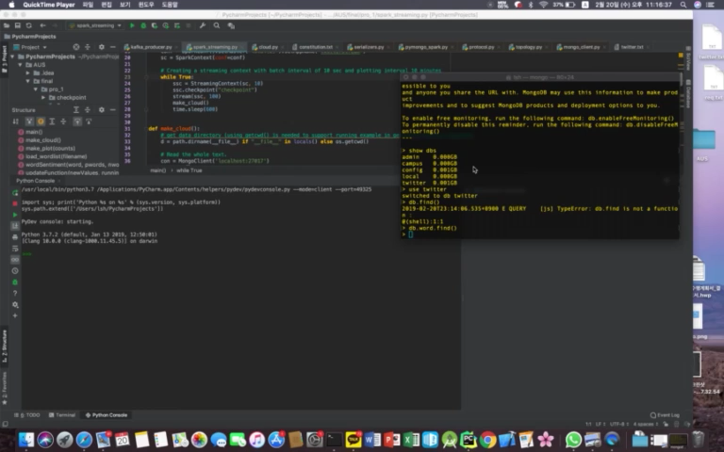
Problem SetC(1,2)

Slide 15
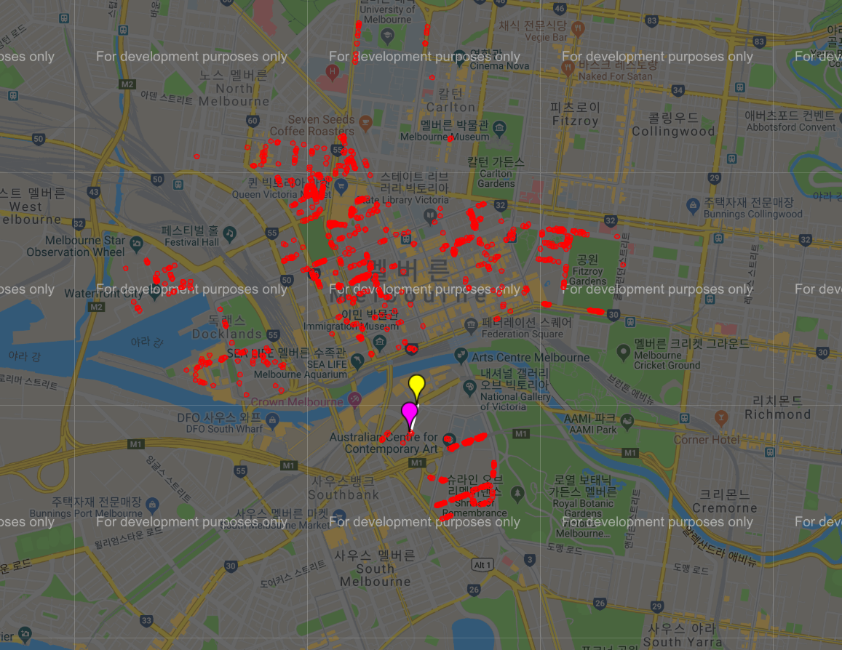

Problem SetC(3)
Description:
By utilizing open sensor data from Melbourne's open data platform in particular on-street parking bay sensors data, presenting the available parking spaces in the google maps as well as displaying the closest parking spot from your location.

Slide 16
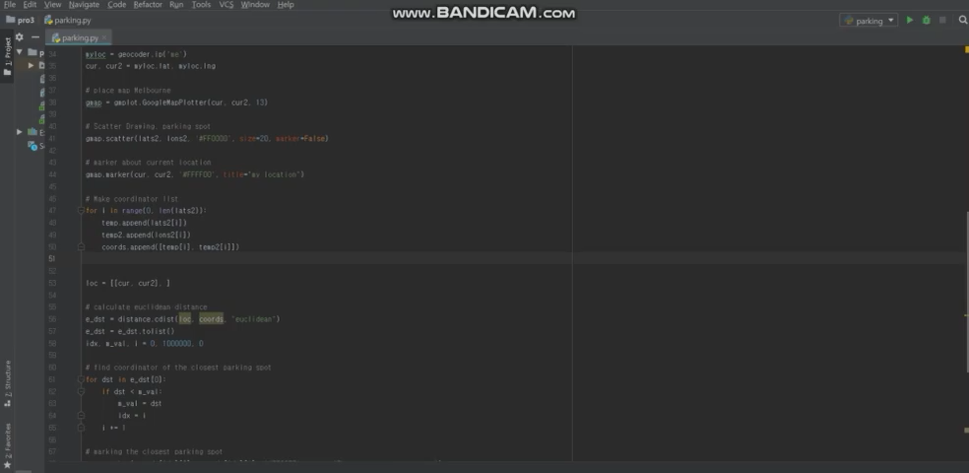
Problem SetC(3)

Slide 17

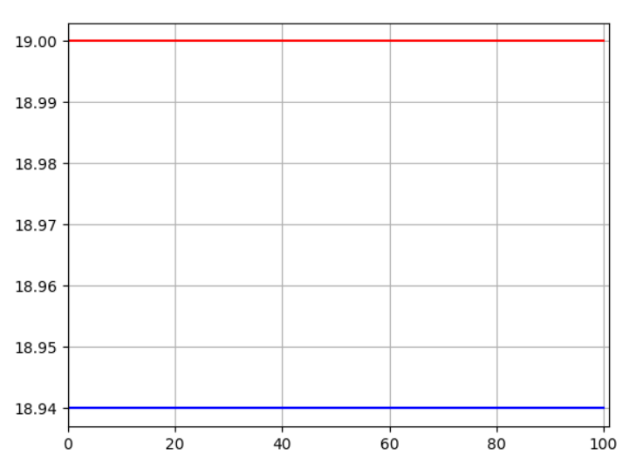
Problem SetC(4)
Find the coolest and hottest place in Australia(Victoria) in real time
Solving steps:
1. Using JSON parsing, gather temperature data from the weather api.
2. And make a request to the collect the data. Then, get data as json format.
3. Find the city and temperature that have max and min temperature.
4. Draw the graph about temperature.

Slide 18
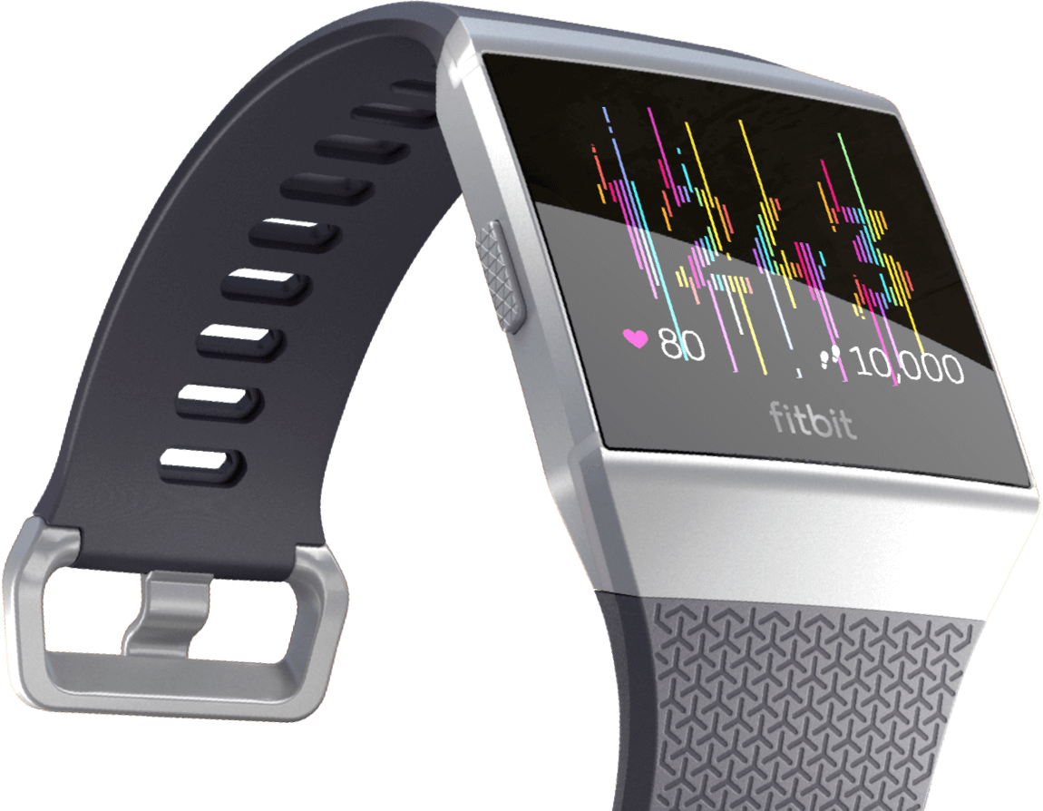
Problem SetC(5)
Real time Plotting of Fitbit data
Description: We use heart rate API to get heart rate data. Producer transform the data in 5 minutes interval and Consumer is plotting. In Consumer , if value is less than 90 or greater then 140 then store it in the mongoDB

Slide 19
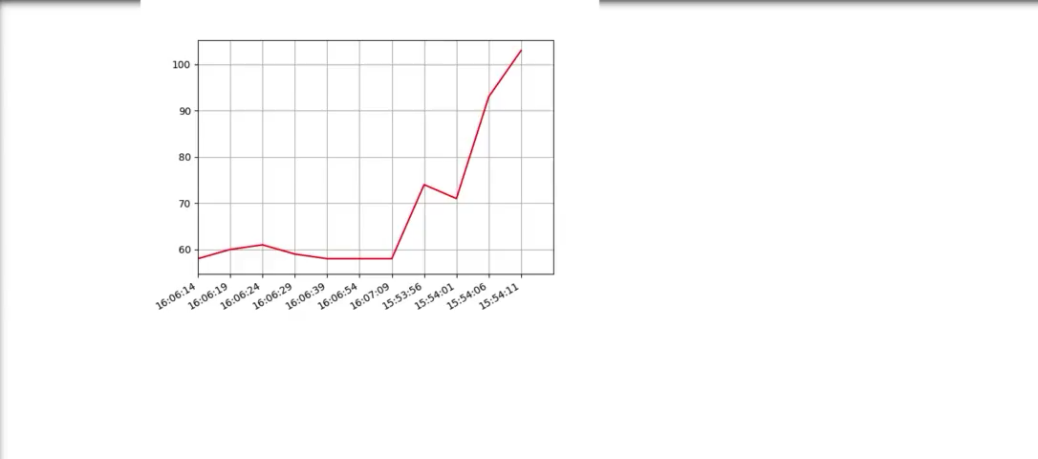
Problem SetC(5)

Slide 20
End of Document

